Slide 1
IT Security
Presented by:
Trisha Craig and Don Elsner
Principal Auditors – IT Audit
Duke University

Slide 2
Agenda
Stakeholders
What is “Internal Audit”
Office of Internal Audits
Information Technology Audit
Audit Process and IT Audits
IT Controls
SOM Compliance Review Audit Scope

Slide 3
Stakeholders
Board of Directors
Audit Committee
Senior Management
External Audit
Internal Audit
Audit Clients

Slide 4
Stakeholder Roles
Joint effort:
Board of Directors – determines and approves strategies, sets objectives and ensures the objectives are being met.
Audit Committee – responsible for overseeing the internal control structure (operations, compliance, and financial reporting)
Senior Management – defines, develops, implements, and documents the internal control structure
External Audit – attests to the fair statement of financial results
Internal Audit - validate the internal control structure by analyzing the effectiveness of internal controls

Slide 5
Definition of Internal Audit
Institute of Internal Auditors (IIA) Standard
Internal auditing is an independent, objective assurance and consulting activity designed to add value and improve an organization’s operations. It helps an organization accomplish its objectives by bringing a systematic, disciplined approach to evaluate and improve the effectiveness of risk management, control, and governance processes.

Slide 6
Duke Office of Internal Audits

Slide 7
IT Audit Role
Advising the Audit Committee and senior management on IT internal control issues
Performing IT Risk Assessments
Performing:
Institutional Risk Area Audits
General Controls Audits
Application Controls Audits
Technical IT Controls Audits
Internal Controls advisors during systems development and analysis activities.

Slide 8
IT Audit Process
Words that come to mind when you hear “Audit”
Proctology
Chinese Water Torture
Root Canal
You may be wondering "why me?"
Understanding the reasons for an audit and the process involved can help alleviate your fears
The audit process is generally a ten-step procedure:
Notification & Request for Preliminary Information
Planning
Opening Meeting
Fieldwork
Communication
Draft Report
Management Responses
Closing Meeting
Report Distribution
Follow-up

Slide 9
IT - General Controls
IT Concerns and Issues
Physical Security
Physical Access
HVAC
Fire Protection
UPS
IT Controls
General
Controls
Backup/Contingency Planning
Data Backups
Restore Procedures
Offsite Storage
Change Management
Program Change Controls
Tracking
Change Approvals
Disaster Recovery
Business Resumption Plans (BRP)
BRP Testing
Alternate Processing
Logical Access
Process to grant, change and remove access to network, application and database

Slide 10
IT - Application Controls
IT Concerns and Issues
IT Controls
Input Controls
Data Entry Controls
System Edits
Segregation of Duties
Transaction Authorization
General
Controls
Application
Controls
Processing Controls
Audit Trails
Interface Controls
Control Totals
Access Controls
User-IDs/Passwords
Data Security – regulations
Network Security
Security Administration
Access Authorization
Output Controls
Reconciliation
Distribution
Access
Notes:
.

Slide 11
Audit Approach for SOM Compliance Review
PI interviews (What and Where)
IT Support Staff interviews (GCC)
eIRB (RDSP) & ISOP review

Slide 12
General Computers Control Review
IT Administration – policies and procedures
Logical Access: Evaluate and assess the process of granting, removing and changing access rights for systems, applications, databases and infrastructure (including but not limited to assessing segregation of duties and logging)
Computer Operations: Evaluate and assess backup processes, job scheduling, patch management, system availability and disaster recovery planning/testing
Vendor Management: Review of 3rd party access, contracts and IT responsibilities, Business Associate Agreement (BAA)
Physical Security and Data Center Environmental Controls

Slide 13
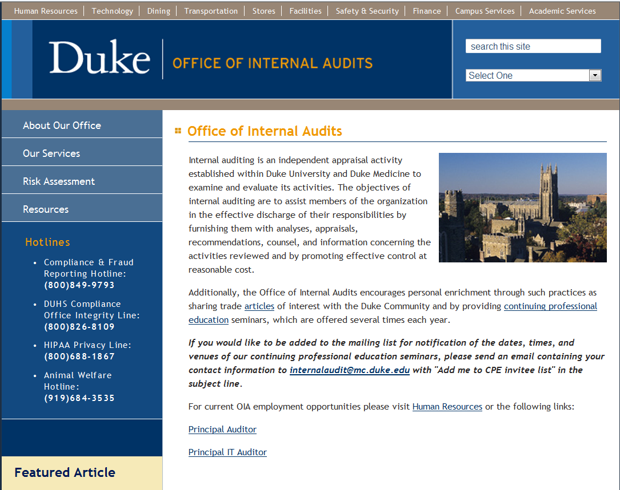
http://www.internalaudits.duke.edu - Hotlines

Slide 14
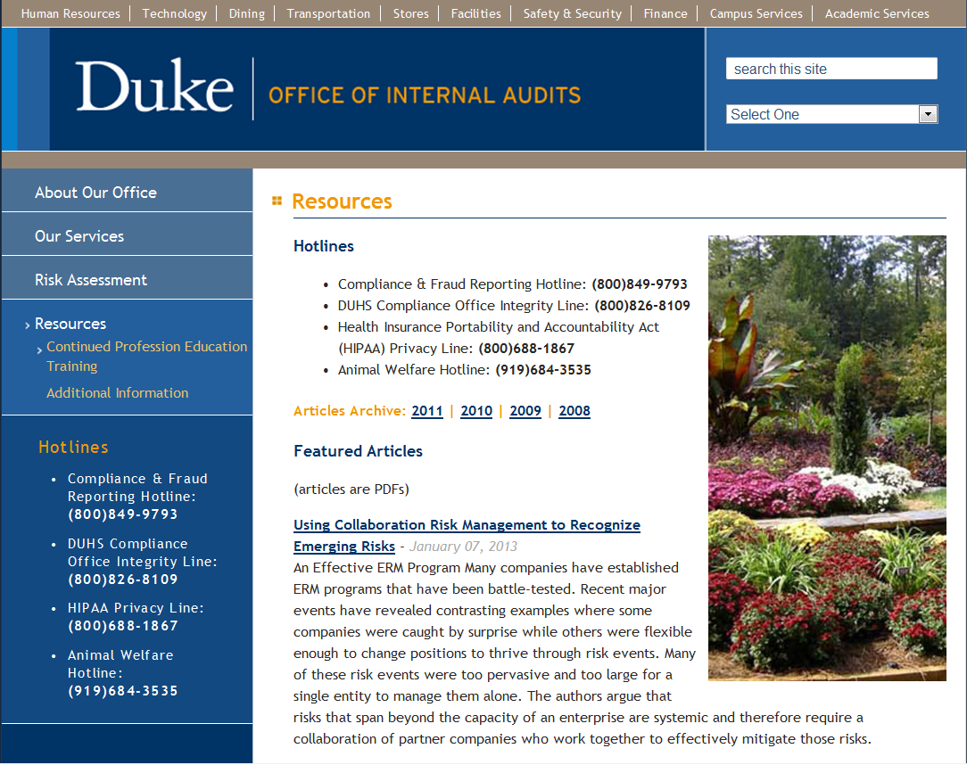
http://www.internalaudits.duke.edu - Resources

Slide 15
Questions?

